Slide 1

Web scraping to gain company insights
19/01/2024

Slide 2
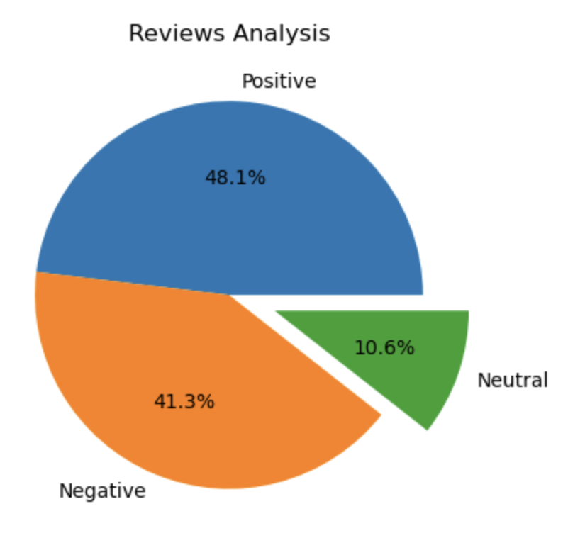
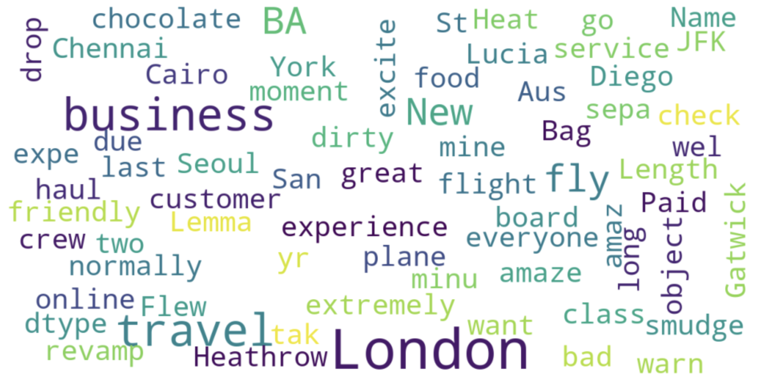
INSIGHTS FROM CUSTOMER REVIEWS
From cleaning 1000 reviews given by the customers, we obtained
Positive Reviews - 481
Negative Reviews - 413
Neutral Reviews – 106
Word cloud of keywords used in reviews

